Slide 1

18F Wireframes
By Adam D’Angelo

Slide 2

Drug Recall Information Center
Enter the name a drug…
Search
Recent drug recalls
Severity Name Date of recall
Low Drug #1 5/29/15
Shows top ten recent drug recalls by date
High Drug #2 5/29/15
Medium Drug #3 5/29/15
Notes:
Homepage

Slide 3
Drug Recall Information Center
Enter the name a drug…
Search
Search results
Severity Name Date of recall
Displays drug recalls related to the name the user entered.
Low Drug #1 5/29/15
High Drug #2 5/29/15
Medium Drug #3 5/29/15
Notes:
Search results screen

Slide 4
Drug Recall Information Center
Drug #1 Recall Details
Drug details here from FDA
<Image of drug here from NiH>
Low
Additional information
Hyperlinks to Google search results here for “<drug name> + recall” and <drug manufacturer> + recall”.
Back to search results
Notes:
Drug recall details

Slide 5
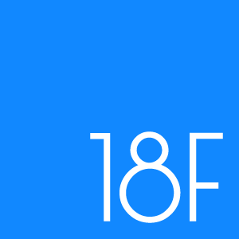
Logos:
Background and Fill Colors:
Body Text – Arial/Sans Serif, 12 pt
Form Fields or Buttons – Arial 12pt Bold
Heading – Arial/Sans Serif Bold 16 pt
Font:
Accent Colors:
Use red sparingly, if at all.
18F Logo Color:
We may want to use their instead of our, or add it in in places.

Slide 6








Icons

